Slide 1
Data Science: Big Data Management Systems & Tools
Module 9: Big Data Architecture

Slide 2
Module 9 Summary
Learning Outcomes
Define IT architecture
Contrast the LAMP and SMACK (Spark, Mesos, Akka, Cassandra, Kafka) stacks
Introduce Kafka
Describe the Lakehouse concept
Discuss key techniques for securing the pipeline
Notes:
Common architecture (tooling) in the big data world

Slide 3
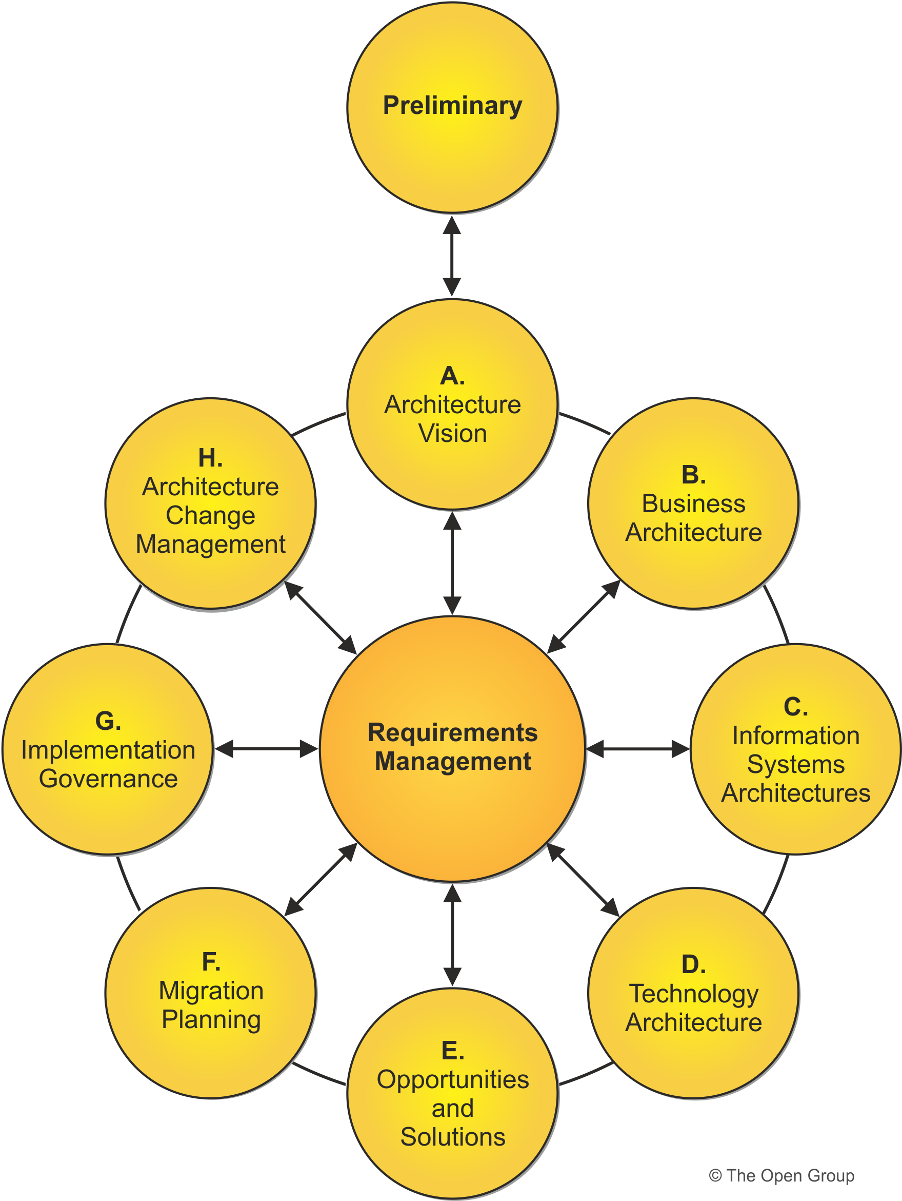
IT Architecture
Source: https://www.opengroup.org/togaf
Notes:
An IT architecture considers many requirements as a whole and not just the tools and technologies. These requirements are defined by the business. Things such as governance, can we store all time historical data in our warehouse? As an architecture you take all these requirements and design your solution. An architect does not just stop at the requirement, they must also look forward to see where the companies data needs might be down the road and how we can prepare for it now.
Historically, we have been using historical analytics to do forecasting, but now more and more companies are moving to advanced solutions involving predictive analysis through techniques such as ML.

Slide 4
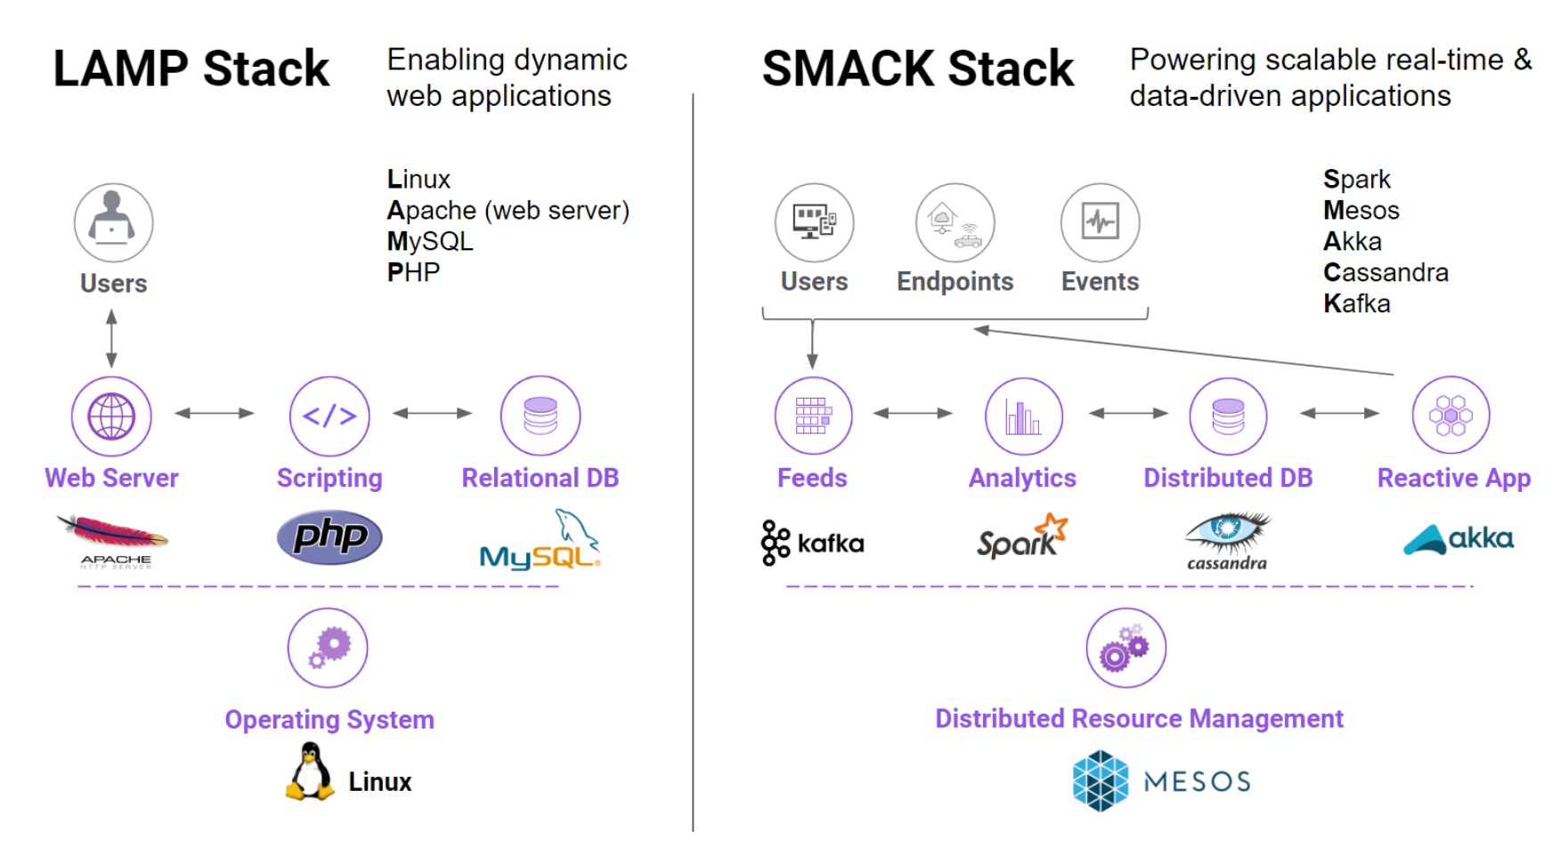
LAMP vs SMACK stack
Data is captured in real-time in a fast, replicated publish-and-subscribe queue such as Kafka.
A stream processor such as Spark Streaming, Samza, Storm, or Flink is used to do near realtime analytics.
Data is persisted using a distributed DBMS, such as Cassandra or HBase.
Non-blocking asynchronous applications using a concurrency framework based on Futures or Actors (e.g. Akka) can be built on top.
Increasingly, the entire datacenter is being virtualized using tools like Mesos, Kubernetes, or Ignite/GridGain.
Notes:
Now lets compare the traditional technology stack vs the modern technology stack:
LAMP is traditional: in this we see a user which is interacting with some web server, which is being powered by a scripting language, which then talks with a relational DB to perform some operation.
SMACK is modern, more real time: in this case we have some user or some entity (a car sensor) interacting via data streaming on kafka. Kafka acts a broker that receives data and then allows others tools to retrieve data. Now spark comes in and uses that data and processes (makes a decision), the input and output of that decision can then be stored in a disturbed DB, and then lastly sent to some front end application. Key here is that we are able to process large amounts of data very quickly due to this distributed setup.
Note that LAMP is perfectly fine for a simple web application, something that does not need to deal with large amounts of data and continuous processing.

Slide 5
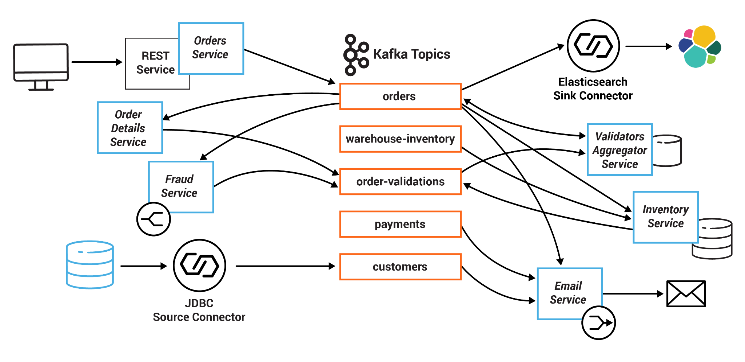
Kafka - Distributed Pub/Sub Messaging
High-velocity streaming data
Buffers data so it isn’t lost
Data is partitioned by key
Partitions of a topic can be stored in many modes in cluster
Source: https://docs.confluent.io/platform/current/tutorials/examples/microservices-orders/docs/index.html
Notes:
Kafka - Distributed Pub/Sub Messaging
A common tool to handle vast amounts of incoming data is Kafka
Kafka is able to buffer data so it isnt lost, and can partition it by key since the incoming data is distributed.
The example on the screen shows us applications (internal and external) on the left hand side, which feeds the data into a kafka topic.
One the right hand side we have the consumers (also known as subscribers) of this information. They are notified when new data has arrived for their topic.
The beauty of this system is the published does not need to know who the subscribers are and vice versa.

Slide 6
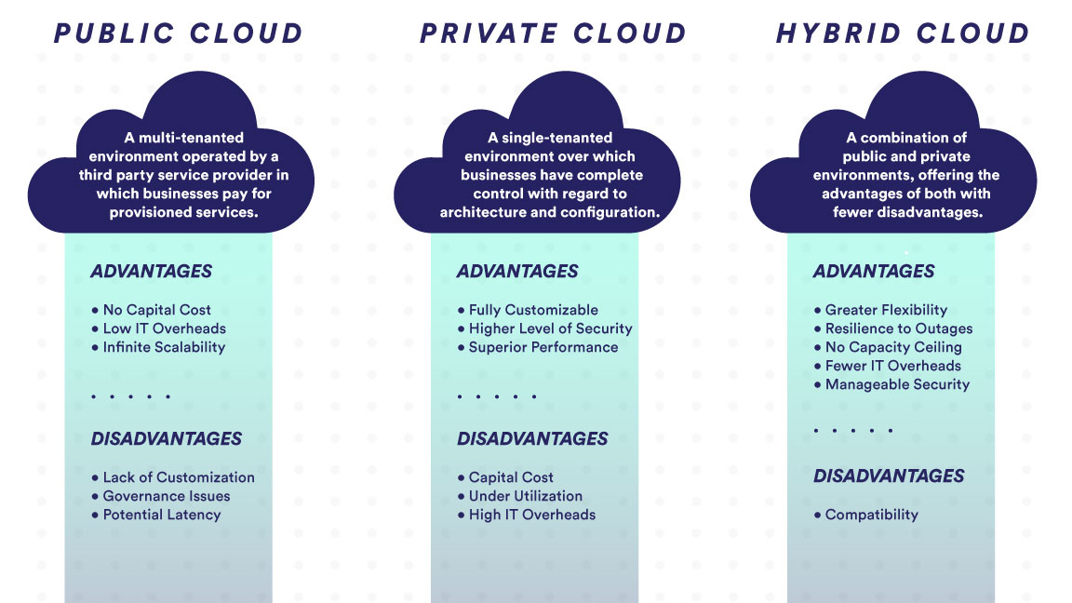
Migration to Cloud
Notes:
Another common pattern in IT Architecture is migrating to the cloud.
A primary reason companies do this is due to the high cost of managing an on premise stack. Especially when you move into a distributed data world. Managing 100s of nodes becomes very expensive and difficult.
A common solution is to move to cloud. Within that we have a few different options.
Public cloud is a multi tenanted environment, operated by 3rd party services like microsoft azure, GCP, AWS.
Advantages: no capital cost as you are not managing the hardware, infinite scalability to grow with a few click
Disadvantages: lack of customization, potential governance (depending on industry, and geolocation). Think moving to a cloud database which does not connection to your BI tool. Potential latency (very minimal due to advancement in the industry), but can be there since consumer and storage are not physically near each other.
Private cloud is single tenant environment, where you have complete control of architecture and configuration.
You work with the cloud provider to help you set this up on premise.
Advantages: full customizable, higher level of security and performance
disadvantage : higher cost on capital and overhead, and under utilization because you can grow it but not shrink it too easily
Hybrid cloud is a mix of both
Advantages: more flexible, resilient, and cheaper. This is very common within banks, where some data can live private and some in the cloud.

Slide 7
The promise of good data management
In the 1980’s companies began moving away from siloed databases to a central storage for reporting called the data warehouse (DWH)
However, in larger organizations often times there would be multiple DWHs which is what the DWH was intended to avoid
Some organizations (with single DWH) would create smaller subsets of data within a DWH called data marts (e.g. marketing, finance, operations)
Most of the data that companies worked with at this time was DWH friendly, but as the internet grew in popularity so did the need for a new solution to store that data
Notes:
A long time, companies complained that they did not have a full view of there customers because their entire dataset was never available for one person to analyze
To solve this, a central storage solution was created (mainly for reporting) known as the DWH
However, as people used the DWH, they ended up right back at the start, where each department within a company had its own data warehouse or datamart that again failed to provide the full view of the customer
The issue here is that usually companies end up with redundant dataset which does not match and cost a lot to maintain
As the internet grew, a lot company started to store data that was not DWH friendly (aka not structured)

Slide 8
Capture then retain then analyze
Around 2005, Hadoop was created, designed for capturing huge quantities of raw data
HDFS was different in the sense that it did not need a defined schema to store data
This eventually led into the concept of a data lake, a central repository for capturing all raw enterprise data
Typically, data lake technology is free, open source, and uses cheap servers
However, data lakes were not a full solution as they lacked
ACID support, data quality enforcement, difficult on appending, handling of small files, handing of metadata
Notes:
So in came a solution called hadoop to store large amounts of raw data
HDFS (hadoop filestore) was different from a DWH because it did not need a defined schema to store data (also any type of data)
This then eventually led to the concept of a data lake which stored raw enterprise data
HDFS was free and cheap to run BUT it lacked native things like ACID support, which made it difficult to use

Slide 9
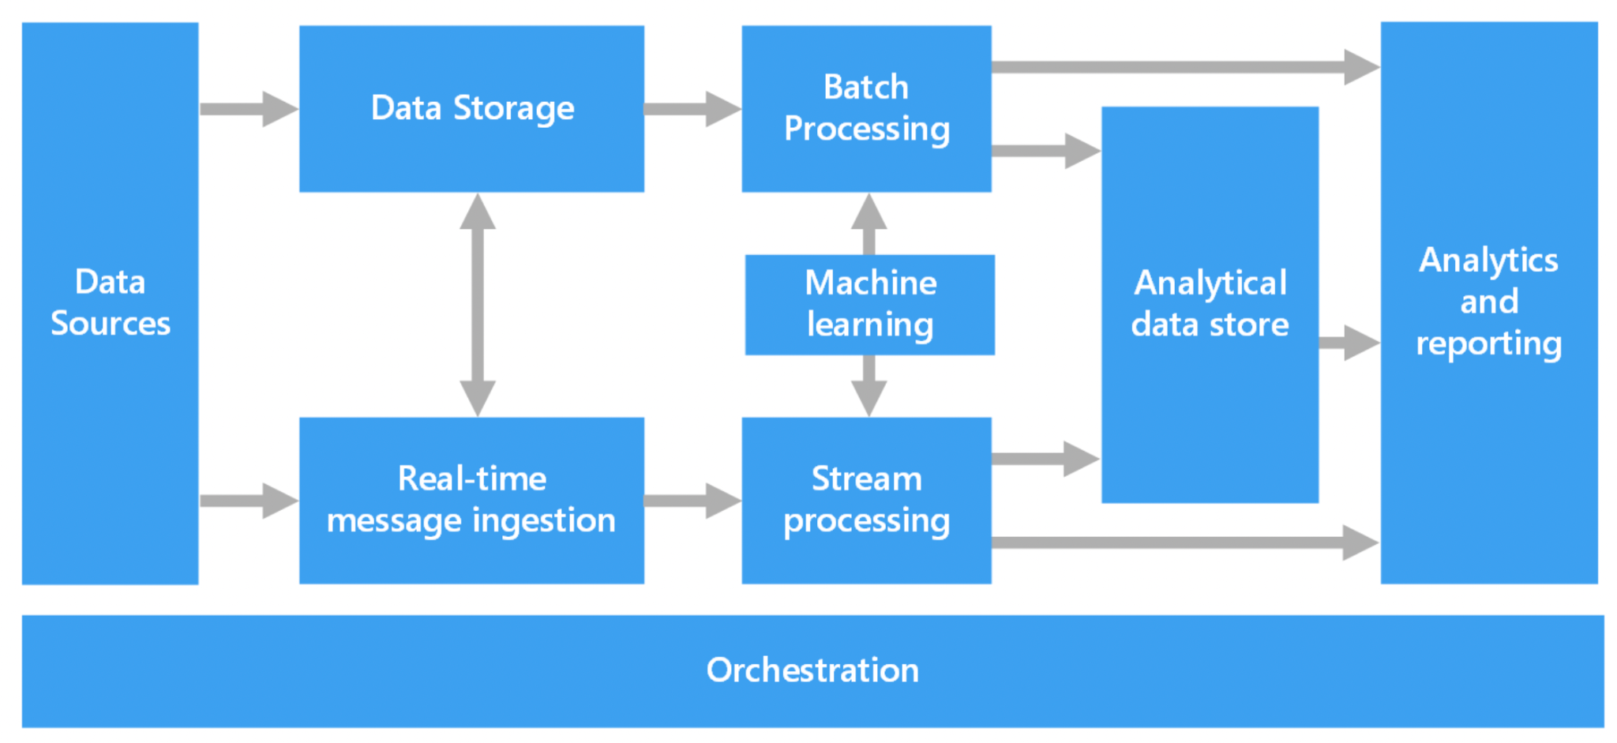
The ideal solution
What we would like is a single architecture that can be used for as much of the functionality
Notes:
So the ideal solution was to have the best of both worlds
DWH for reporting and a Data lake for data science

Slide 10
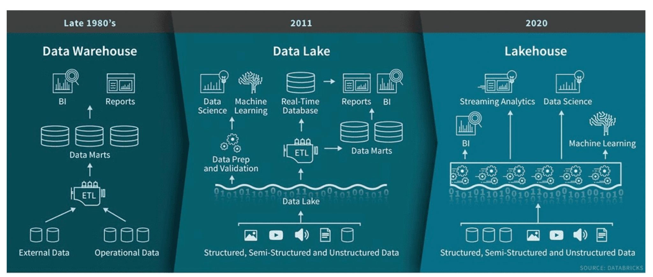
In comes the Lakehouse
ACID
Metadata
Indexing
Schema Validation
Notes:
In comes the concept of lakehouse!
Whereas data lakes are entirely agnostic about what kind of data you put in them, the lakehouse approach specifies how to build data lakes in such a way that you can get much of the benefits of data warehouses: reliability, performance, and data quality management, while retaining the openness and scale of data lakes.
ACID transactions: Every operation is transactional. This means that every operation either fully succeeds or aborts. When aborted, it’s logged, and any residue is cleaned so you can retry later. Modification of existing data is possible because transactions allow you to do fine-grained updates. Real-time operations are consistent, and the historical data versions are automatically stored. The lakehouse also provides snapshots of data to allow developers to easily access and revert to earlier versions for audits, rollbacks, or experiment reproductions.
Handling large metadata: The lakehouse architecture treats metadata just like data. As a result, it can handle large tables and small files.
Indexing: Along with data partitioning, the lakehouse architecture includes various statistical techniques. For example, bloom filters, a trick to avoid unnecessarily scanning through data blocks that can't have any query results in them to avoid reading big portions of the data altogether and deliver massive speed-ups.
Schema validation: All your data that goes into a table must adhere strictly to a defined schema. If the data doesn't satisfy the schema, it’s moved into a quarantine area where you can examine it later and resolve the issues.

Slide 11
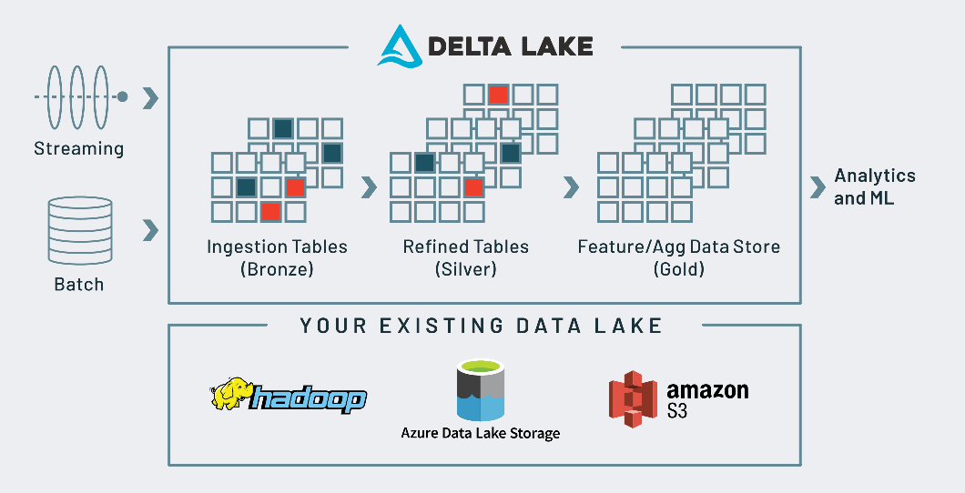
Delta Lake
Notes:
One of the products that supports a data lake is known as delta lake
With this you have the ability to ingest data, within in batch of streaming
From there you store it into a few layers, bronze which is just raw, then you can refine it simple (names, cast, nulls), then aggregate it for end users

Slide 12
Key techniques for securing data
Authentication: The process of determining who a user is
Authorization: The process of determining what a specific user is allowed to do
Identity and access management: Centralized management of user access rights
Security tokens: Strings of characters that grant access but are hard to forge
Firewalls: Specialized routers that control access between one network and another
Symmetric encryption: A single secret key is used for both encryption and decryption
Asymmetric encryption: Uses two different keys, one public and one private

Slide 13
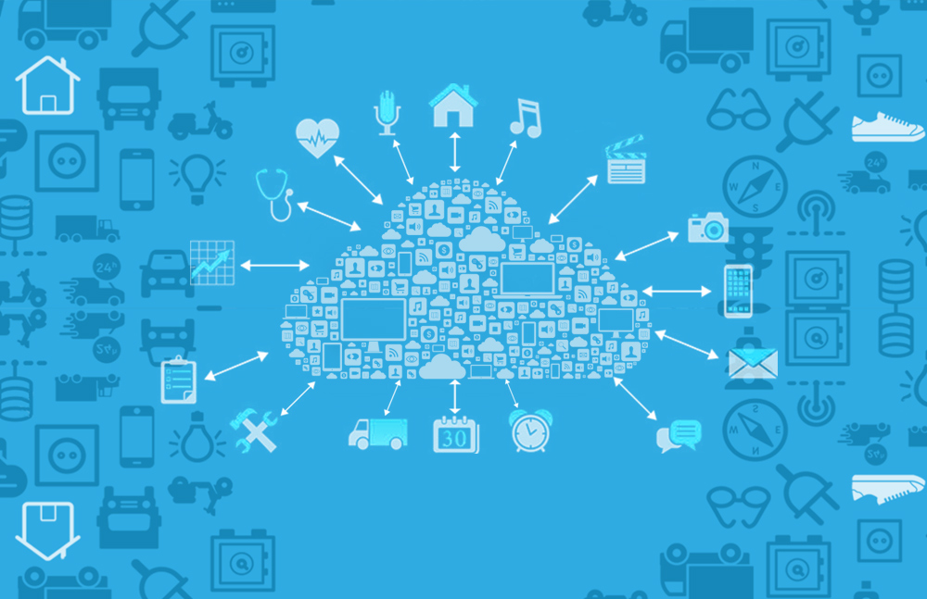
Why is this important?
The performance and security of a big data pipeline is only as good as its weakest link. The entire pipeline must be architected to ensure sufficient end-to-end capacity and security, and to be capable of supporting all the analytics needs of its user communities.

